Slide 1
Practice
Flash Programming
Notes:
1

Slide 2
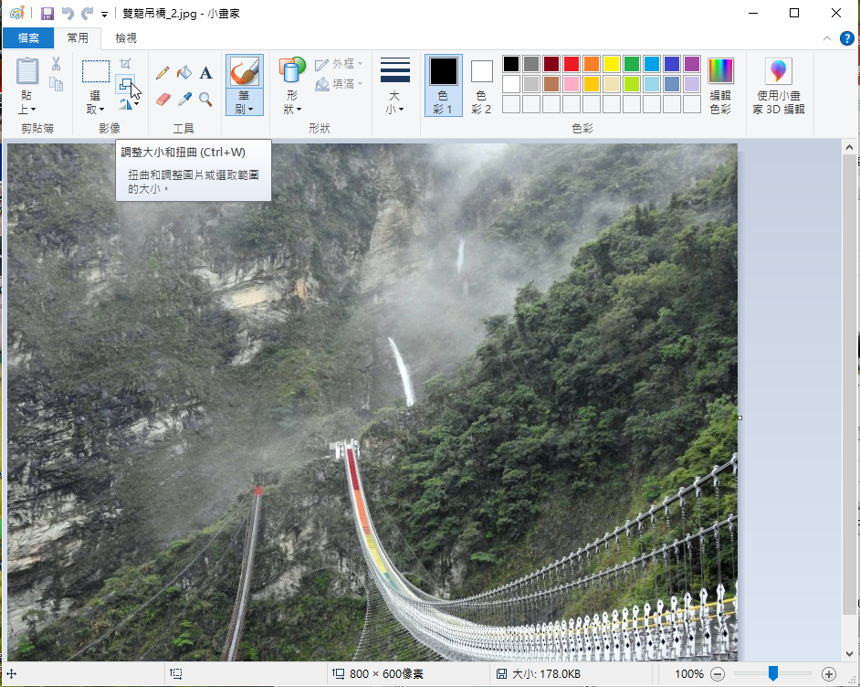
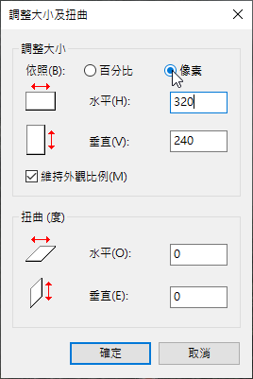

Slide 3
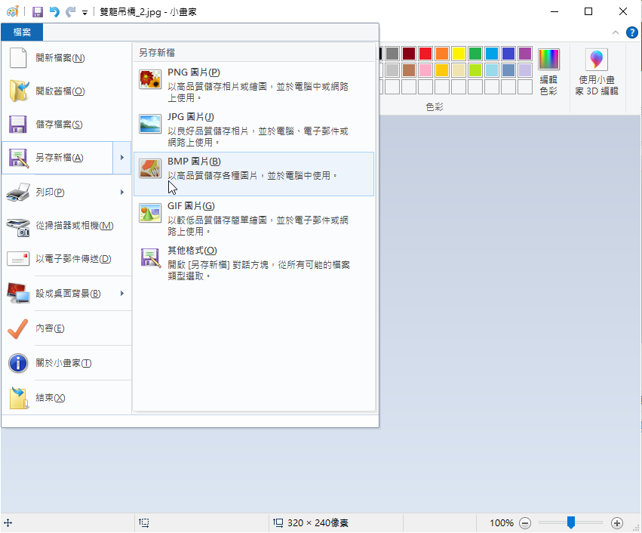
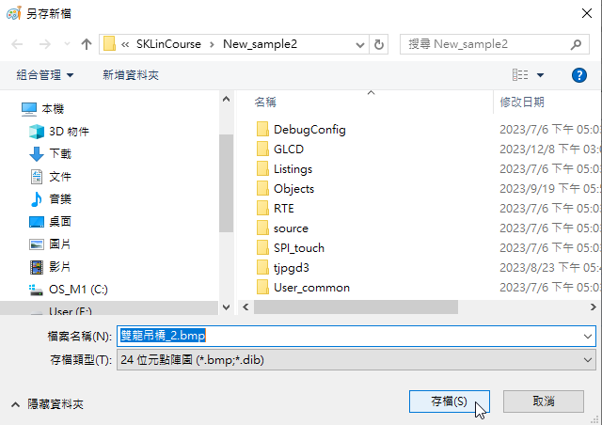

Slide 4
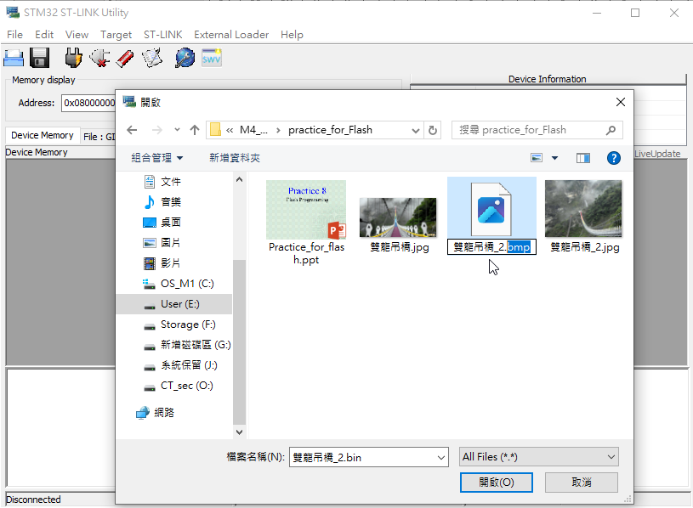
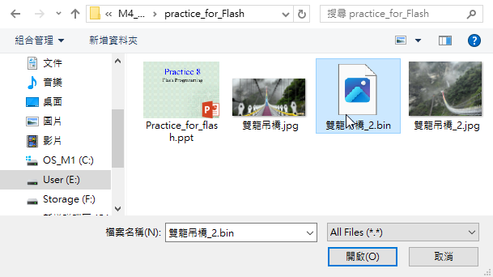

Slide 5
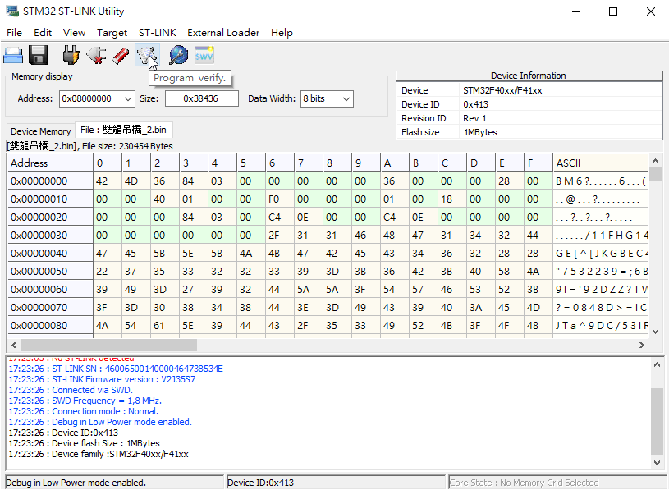
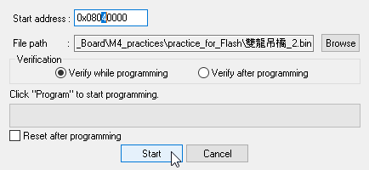
p_bmp Flash_Sector6 = 0x08040000
Notes:
5

Slide 6
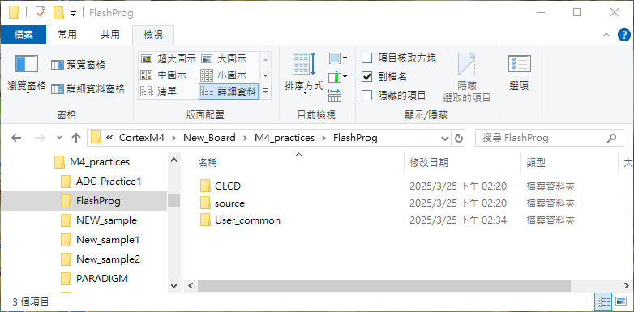
Create a new folder “FlashProg” that has the copies of the folders: GLCD and source from Folder “NEW_sample2”, and User_common from Folder PARADIGM.
Notes:
6

Slide 7
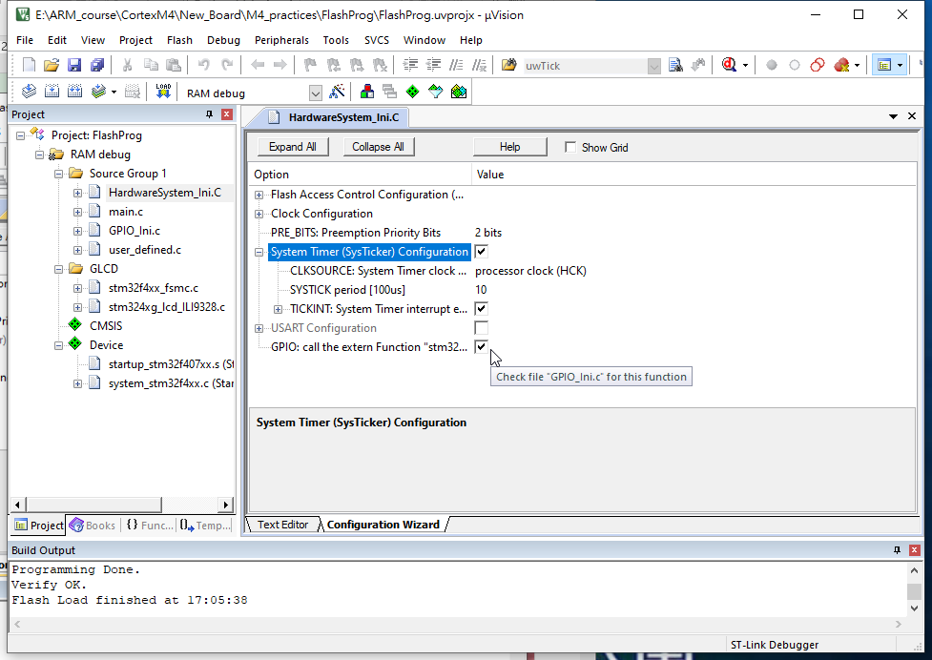
To use
void delay_ms(uint32_t wait_ms) in file user_defined.c,
We should also check
System Timer interrupt

Slide 8
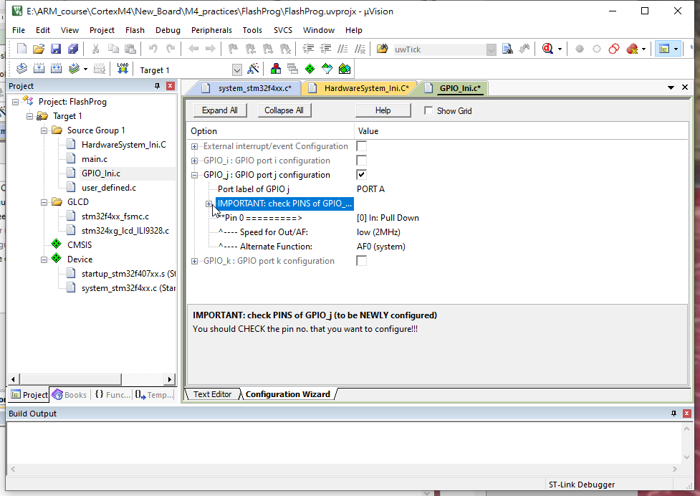
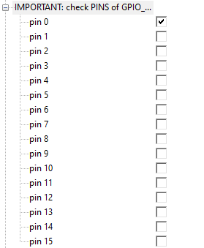
Notes:
8

Slide 9
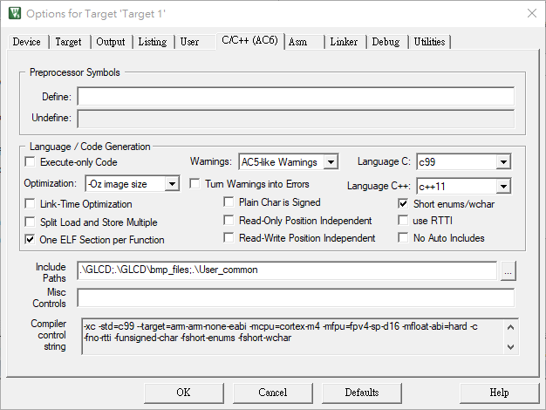
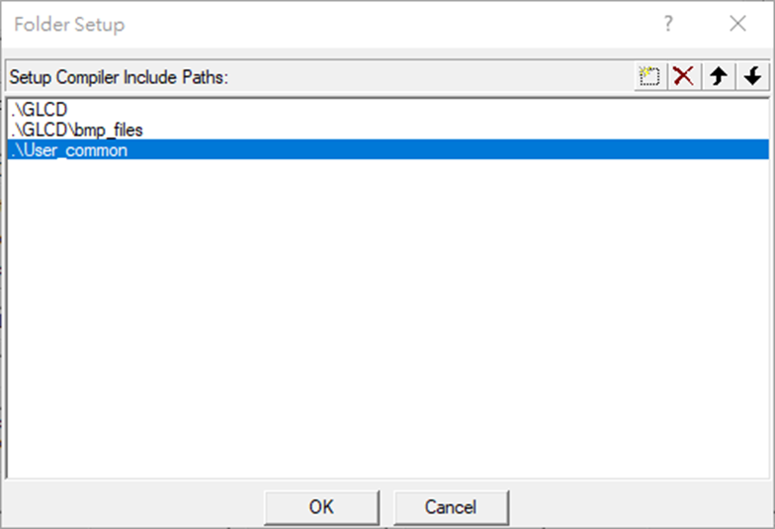
Notes:
9

Slide 10
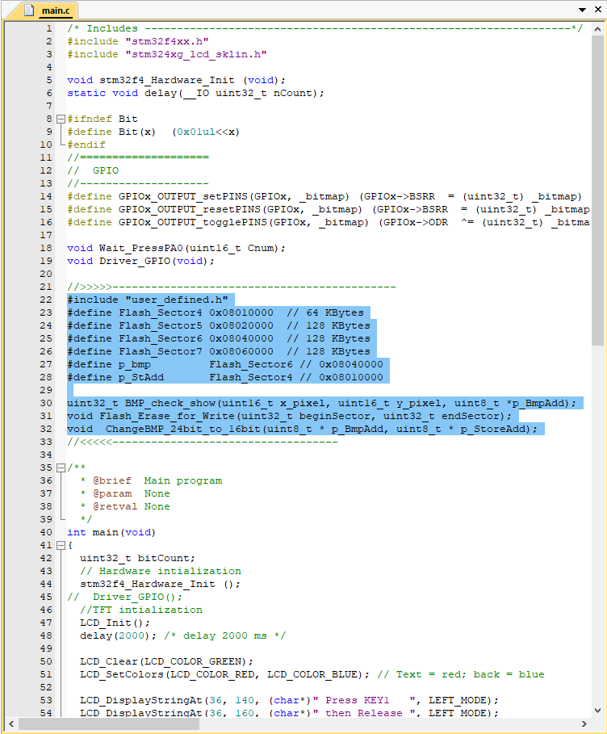
Notes:
10

Slide 11
//>>>>>--------------------------------------------
#include "user_defined.h"
#define Flash_Sector4 0x08010000 // 64 KBytes
#define Flash_Sector5 0x08020000 // 128 KBytes
#define Flash_Sector6 0x08040000 // 128 KBytes
#define Flash_Sector7 0x08060000 // 128 KBytes
#define p_bmp Flash_Sector6 // 0x08040000
#define p_StAdd Flash_Sector4 // 0x08010000
uint32_t BMP_check_show(uint16_t x_pixel, uint16_t y_pixel, uint8_t *p_BmpAdd);
? // in user_defined.h
? // in main.c of project PARADIGM
//<<<<<-----------------------------------
Notes:
11

Slide 12
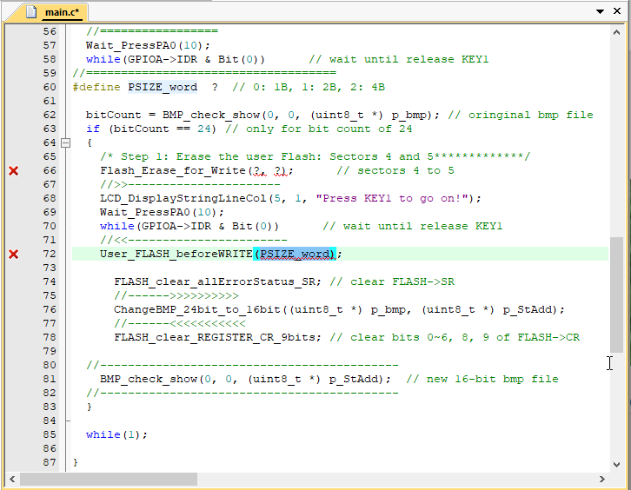
Notes:
12

Slide 13
#define PSIZE_word ? // 0: 1B, 1: 2B, 2: 4B
bitCount = BMP_check_show(0, 0, (uint8_t *) ?); // oringinal bmp file
if (bitCount == 24) // only for bit count of 24
{
/* Step 1: Erase the user Flash: Sectors 4 and 5*************/
Flash_Erase_for_Write(?, ?); // sectors 4 to 5
//>>----------------------
LCD_DisplayStringLineCol(5, 1, "Press KEY1 to go on!");
Wait_PressPA0(10);
while(GPIOA->IDR & Bit(0)) // wait until release KEY1
//<<-----------------------
User_FLASH_beforeWRITE(?);
?; // clear FLASH->SR
//------>>>>>>>>>>
ChangeBMP_24bit_to_16bit((uint8_t *) p_bmp, (uint8_t *) p_StAdd);
//------<<<<<<<<<<<
?; // clear bits 0~6, 8, 9 of FLASH->CR
//-------------------------------------------
BMP_check_show(0, 0, (uint8_t *) p_StAdd); // new 16-bit bmp file
//-------------------------------------------
}
Notes:
13

Slide 14
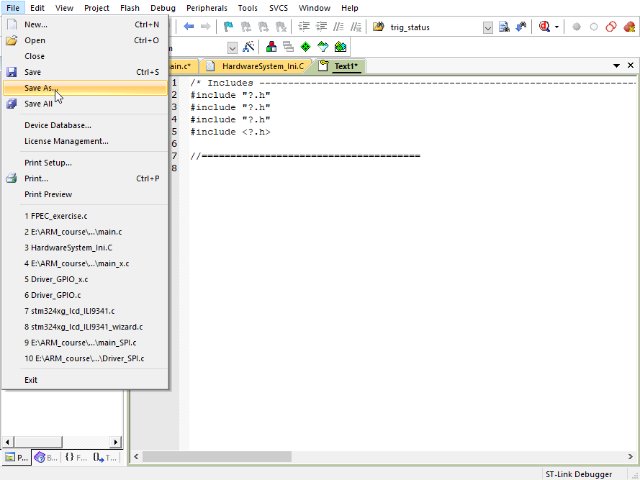
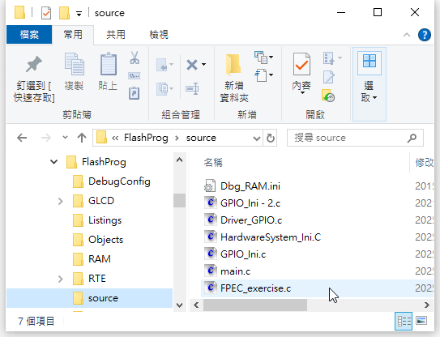
Notes:
14

Slide 15
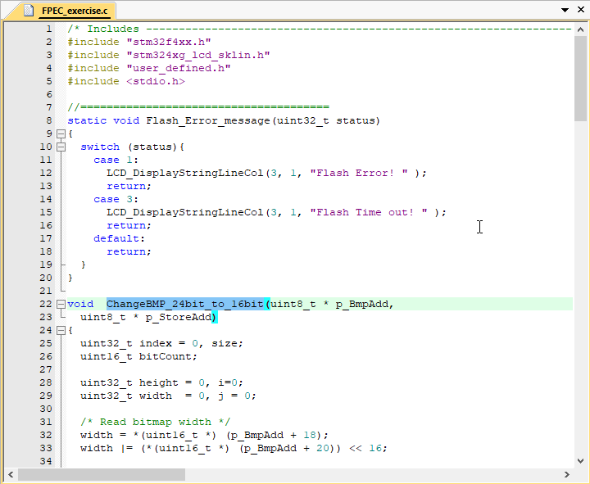
It is copied from the one in file “main_FLASH.c” in project “PARADIGM”.
Notes:
15

Slide 16
/* Includes ------------------------------------------------------------------*/
#include “?.h"
#include “?.h"
#include “?.h"
#include <stdio.h>
//======================================
static void Flash_Error_message(uint32_t status)
{
switch (status){
case 1:
LCD_DisplayStringLineCol(3, 1, "Flash Error! " );
return;
case 3:
LCD_DisplayStringLineCol(3, 1, "Flash Time out! " );
return;
default:
return;
}
}
void ChangeBMP_24bit_to_16bit(uint8_t * p_BmpAdd, ……………….
Notes:
16

Slide 17
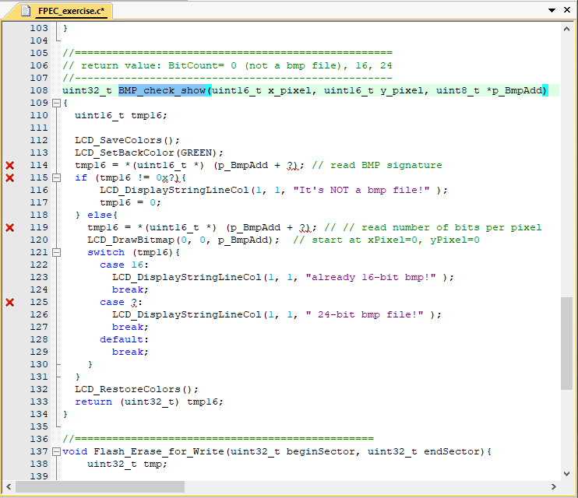
Notes:
17

Slide 18
//===================================================
// return value: BitCount= 0 (not a bmp file), 16, 24
//---------------------------------------------------
uint32_t BMP_check_show(uint16_t x_pixel, uint16_t y_pixel, uint8_t *p_BmpAdd)
{
uint16_t tmp16;
LCD_SaveColors();
LCD_SetBackColor(GREEN);
tmp16 = *(uint16_t *) (p_BmpAdd + ?); // read BMP signature
if (tmp16 != 0x?){
LCD_DisplayStringLineCol(1, 1, "It's NOT a bmp file!" );
tmp16 = 0;
} else{
tmp16 = *(uint16_t *) (p_BmpAdd + ?); // // read number of bits per pixel
LCD_DrawBitmap(0, 0, ?); // start at xPixel=0, yPixel=0
switch (tmp16){
case ?:
LCD_DisplayStringLineCol(1, 1, "already 16-bit bmp!" );
break;
case ?:
LCD_DisplayStringLineCol(1, 1, " 24-bit bmp file!" );
break;
default:
break;
}
}
LCD_RestoreColors();
return (uint32_t) tmp16;
}
Notes:
18

Slide 19
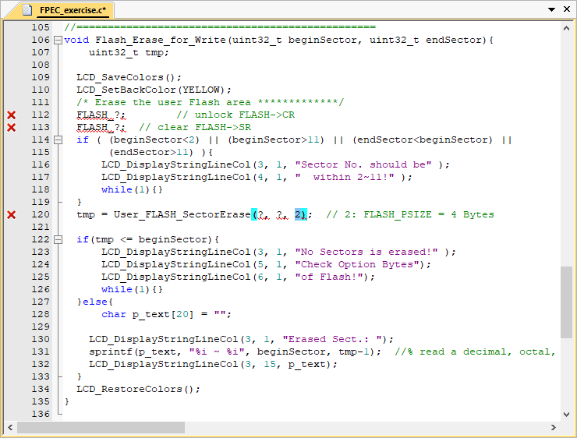
Notes:
19

Slide 20
//================================================
void Flash_Erase_for_Write(uint32_t beginSector, uint32_t endSector)
{
uint32_t tmp;
LCD_SaveColors();
LCD_SetBackColor(YELLOW);
/* Erase the user Flash area *************/
FLASH_?; // unlock FLASH->CR
FLASH_?; // clear FLASH->SR
if ( (beginSector<2) || (beginSector>11) || (endSector<beginSector) || (endSector>11) )
{
LCD_DisplayStringLineCol(3, 1, "Sector No. should be" );
LCD_DisplayStringLineCol(4, 1, " within 2~11!" );
while(1){}
}
tmp = User_FLASH_SectorErase(?, ?, ?); // 2: FLASH_PSIZE = 4 Bytes
if(tmp <= beginSector){
LCD_DisplayStringLineCol(3, 1, "No Sectors is erased!" );
LCD_DisplayStringLineCol(5, 1, "Check Option Bytes");
LCD_DisplayStringLineCol(6, 1, "of Flash!");
while(1){}
}else{
char p_text[20] = "";
LCD_DisplayStringLineCol(3, 1, "Erased Sect.: ");
?(p_text, "%i ~ %i", ?, ?-1); //% read a decimal, octal, or hexadecimal integer
LCD_DisplayStringLineCol(3, 15, p_text);
}
LCD_RestoreColors();
}
Notes:
20

Slide 21
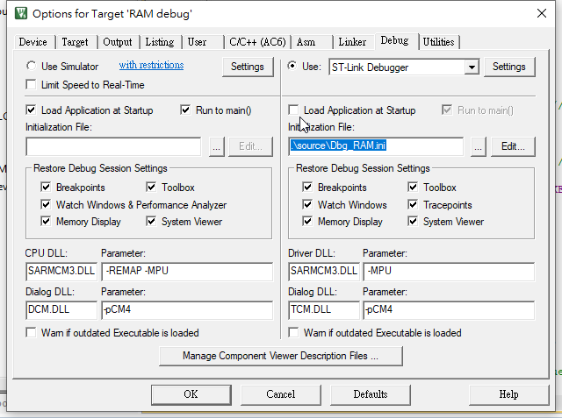
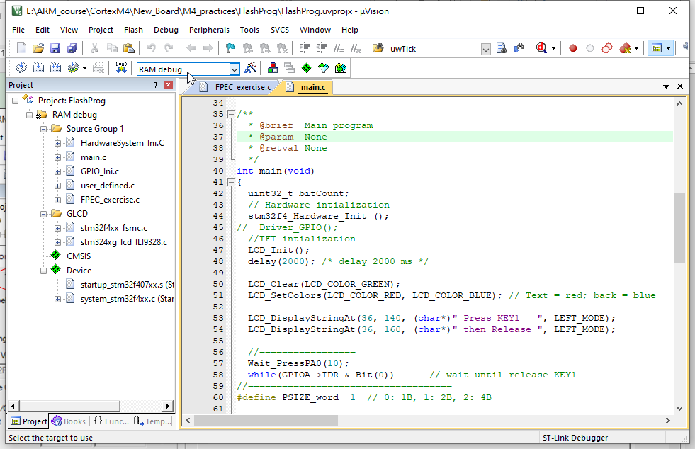
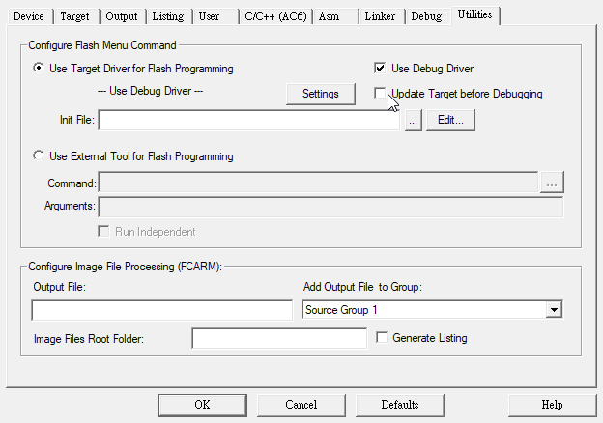
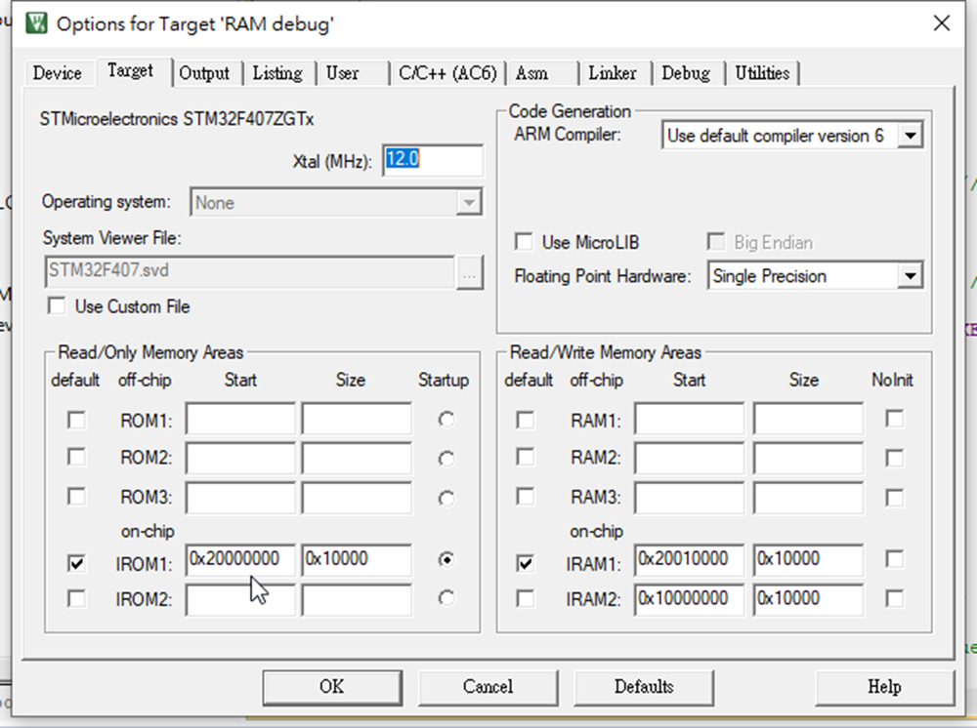
Notes:
21

Slide 22
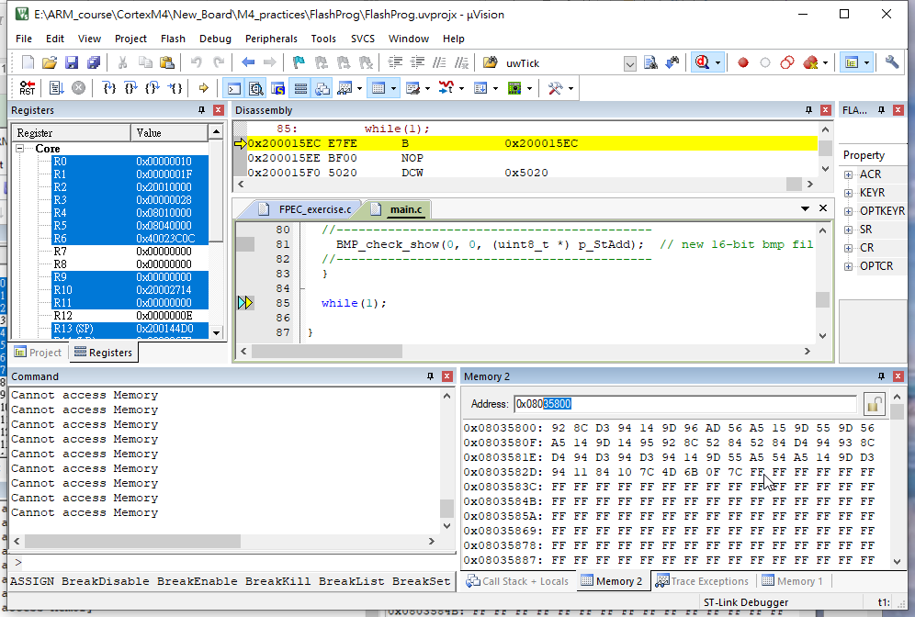
Notes:
22

Slide 23
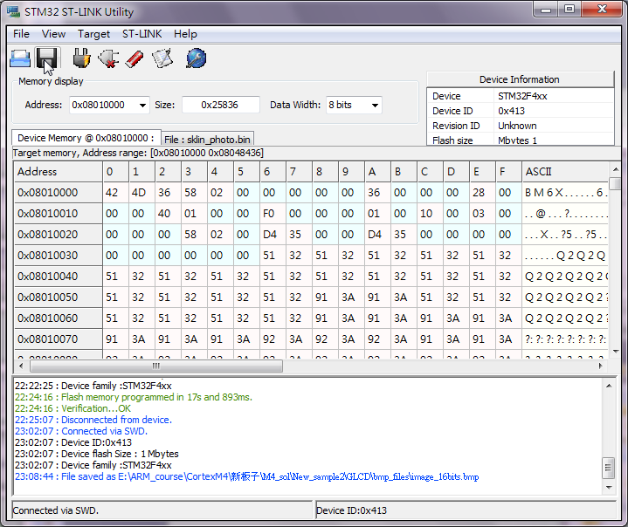
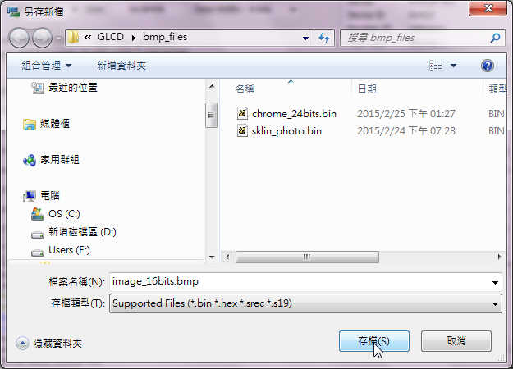
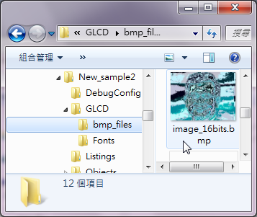
After execution!
Notes:
23

Slide 24
Troubleshooting
Notes:
24

Slide 25
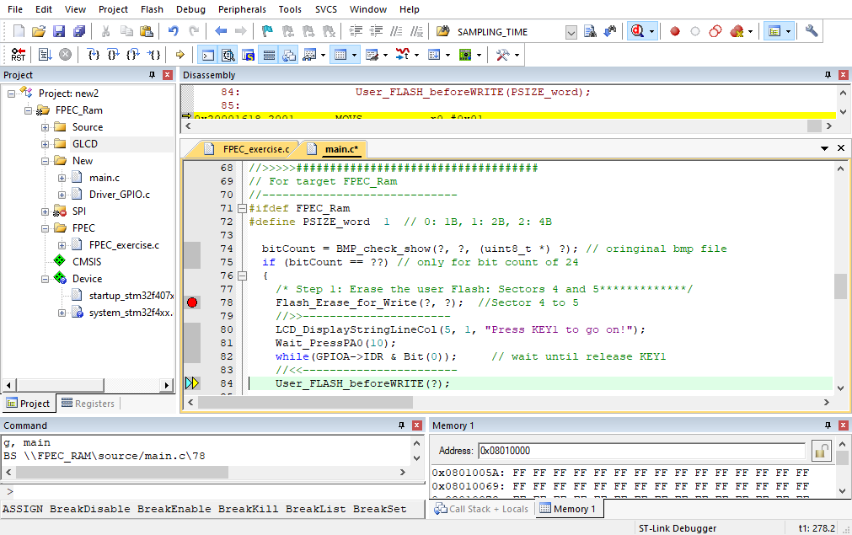
Troubleshooting
Notes:
25

Slide 26
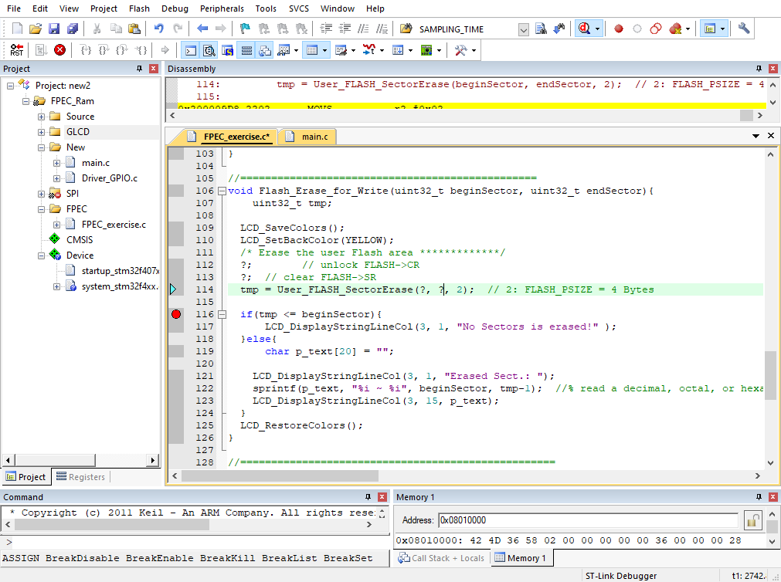
Notes:
26

Slide 27
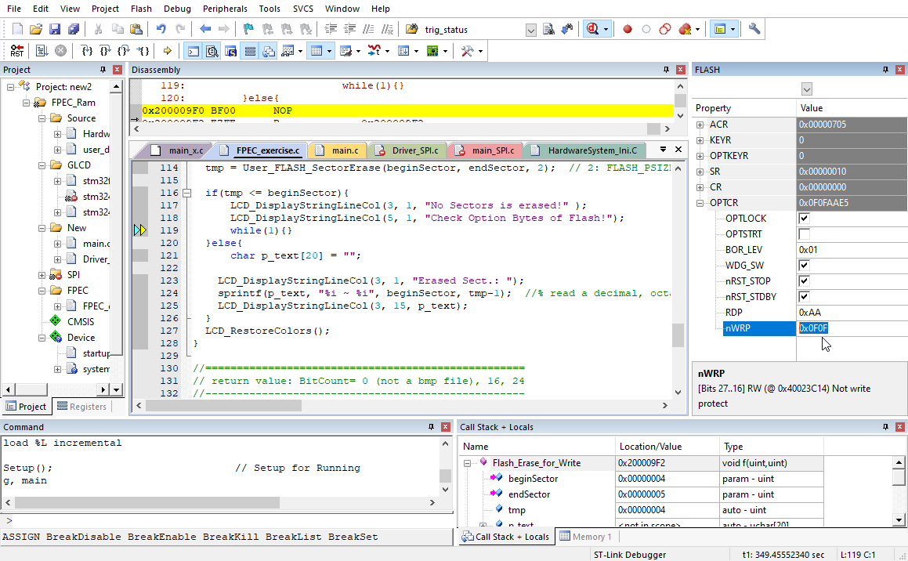
Notes:
27

